Slide 1
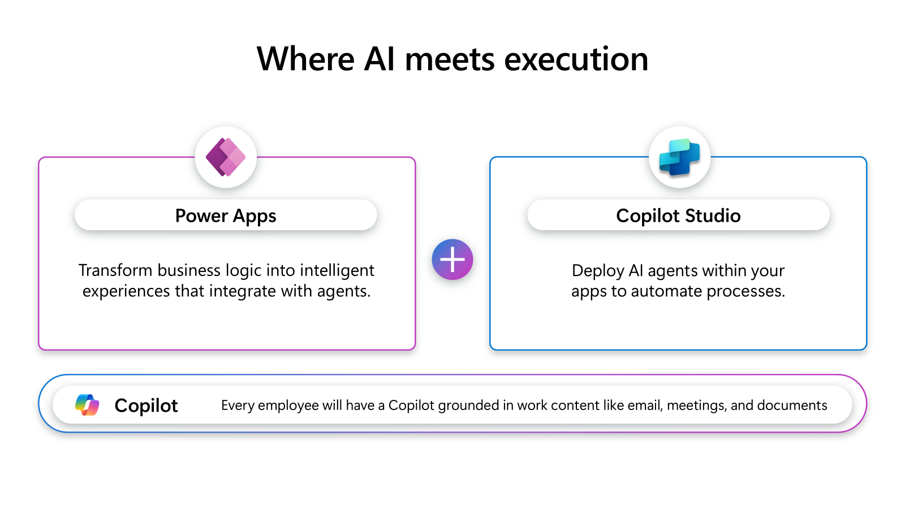
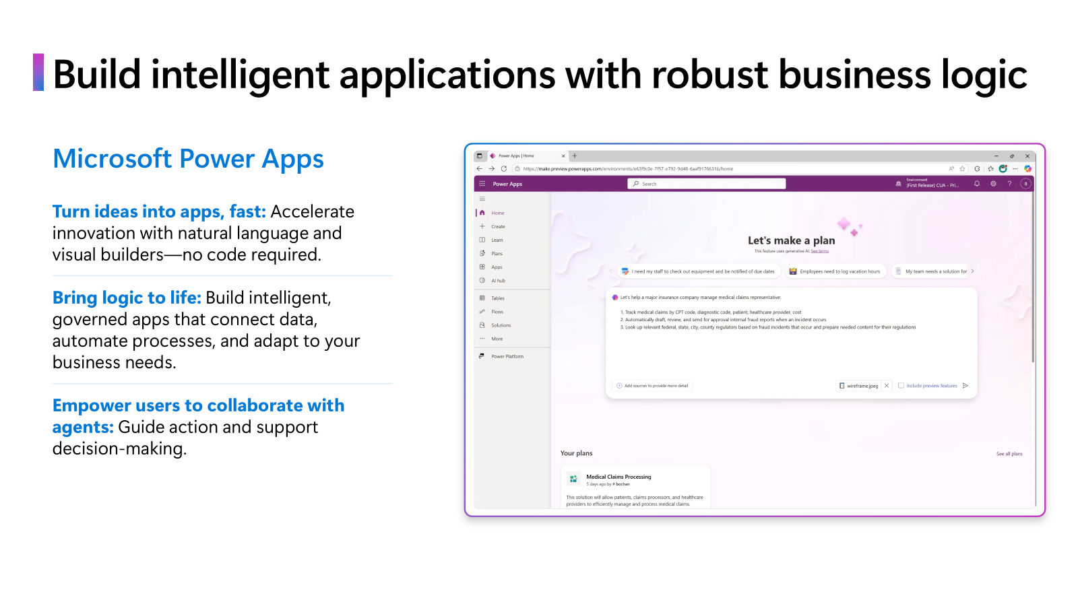
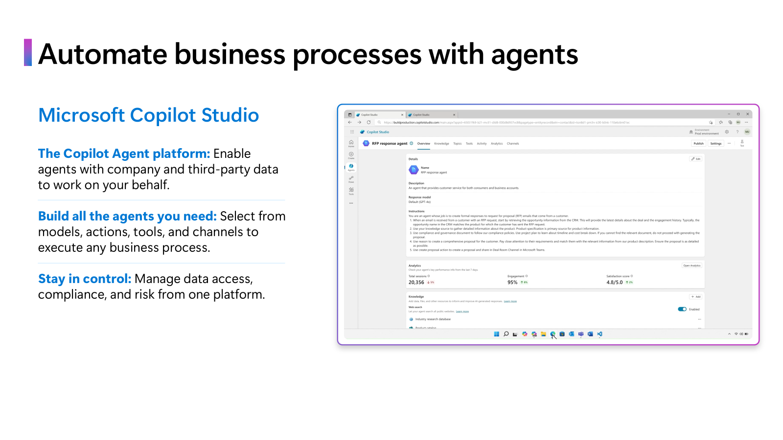
Notes:
To progress to the level of a frontier-first organization, companies need to overcome some common challenges. They can do this by leveraging the power of AI.
Apps aren't just for data entry—they're living storyboards of work. They will continue to exist as our human interface with systems and processes. Apps are also the space in which we collaborate with agents.
Agents aren't just assistants, they're autonomous collaborators. Together, with apps, they transform business processes at enterprise scale by driving actions and results with automation.
Apps combined with intelligent agents empower IT makers by accelerating development and enhancing control.
Power apps gives IT teams the tools they need to build tailored apps. Infusing those apps with intelligent agents that automate and extend their functionality helps you move from reactive to proactive.
You could build agents anywhere, but only Power Platform plus Copilot Studio lets you build, govern, and scale them with the same tools and teams that you already trust.
And with Microsoft 365 Copilot, every employee’s work is grounded in their own work content—like emails, meetings, and documents—so they can move faster, make smarter decisions, and stay focused on what matters most.

Slide 2
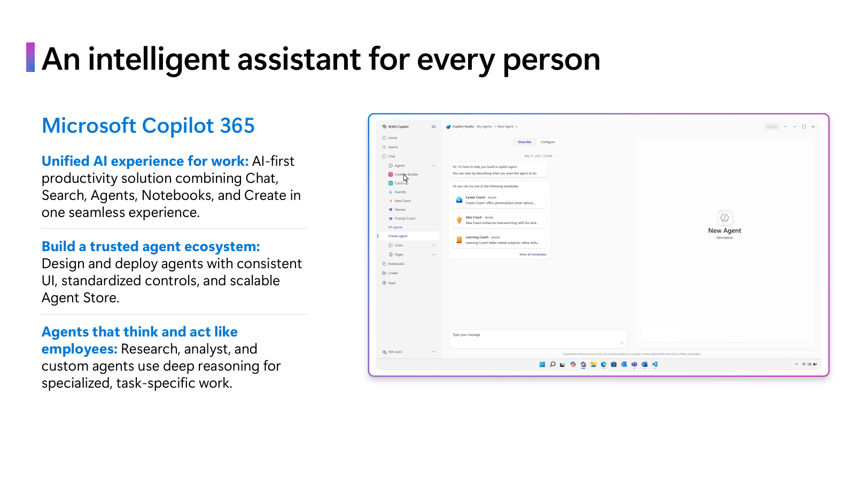
Notes:
Microsoft Power Apps is a new, AI-assisted way to build custom apps.
Using a single prompt, define requirements in natural language, map processes visually, and embed agents that act inside your apps.
Go from business idea to working code in record time. Accelerate innovation with built-in governance, security, and trust — at enterprise scale.
Teams of developer-specialized agents take you from business idea to working code in record time
Define requirements and map processes in natural language
Collaborate with and manage agents inside your apps
Deploy code-first apps to Power Platform with built-in governance, security, and trust.
Plan designer is a copilot-first development tool that lets you quickly create comprehensive business solutions. Describe your business use case in natural language and add relevant images, like business process flows or screenshots of legacy apps. Plan designer generates a complete Power Platform solution tailored to your needs.
Use the new AI-assisted interface to build custom apps that serve as a modern interface to your business systems.
The solution includes Microsoft Dataverse tables, canvas apps, model-driven apps, Power Pages sites, Power Automate flows, and Copilot Studio agents.
Whether you’re designing new agent-infused apps, replacing legacy apps, or building employee portals, Power Apps accelerates innovation. And the built-in governance, security, and trust help you maintain standards and functionality at enterprise scale.

Slide 3
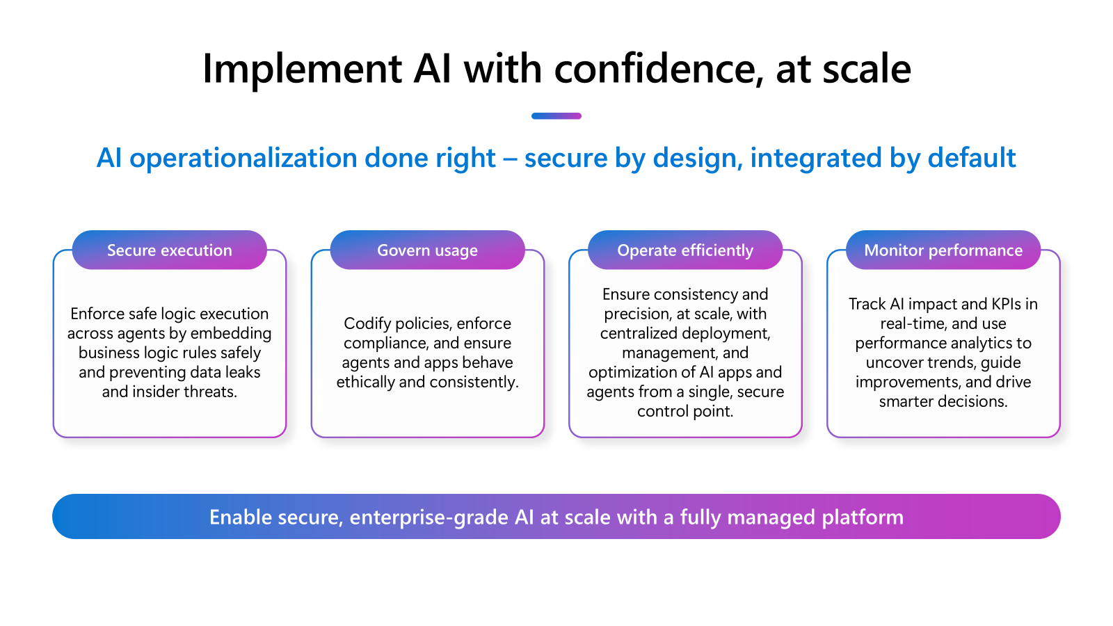
Notes:
Microsoft Copilot Studio helps you accelerate productivity with agent-powered business processes.
Microsoft Copilot Studio enables businesses to create custom copilots using generative AI. The solution democratizes rapid app creation. It integrates seamlessly with Microsoft technologies like Azure AI Studio, ensuring a smooth experience. It integrates and exposes various Microsoft’s conversational AI technology stacks - integrated with Azure AI Studio, Azure Cognitive Services, Azure Bot Framework, Power Platforms AI models, and more.
The platform also offers governance and control, allowing organizations to manage customizations, monitor usage, and maintain security and compliance.
With Copilot Studio, development starts with a prompt, not permissions. You can start with a pre-built agent or create your own using natural language and generative AI.
Your agents can reason over data, retrieve insights, and orchestrate complex workflows across systems. With custom agents, answer questions and complete tasks for individuals, teams, and functions. Agents are AI-powered assistants that autonomously automate processes, freeing employees to focus on strategic work.
With Copilot Studio, you can:
Design copilots from the ground up using generative AI and low-code tools and define exactly what your copilot should do, including how it responds, what data it accesses, and how it integrates with your systems. Connections to internal and external data sources can use pre-built or custom plugins.
Extend Microsoft 365 Copilot with your own enterprise data, workflows, and connectors—ensuring the AI aligns with your business context
Deploy across multiple channels, including Microsoft Teams, websites, and even Facebook. This makes it possible to embed AI into your existing digital ecosystem. You can turn your copilot into a central interface for business processes—from HR and IT support to customer service and sales.

Slide 4
Notes:
Let’s talk about Microsoft 365 Copilot—the unified AI-experience for work. It’s not just another productivity tool, it’s productivity, reimagined
Microsoft Copilot 365 is an AI-first solution that brings together everything you need in a seamless experience. Chat, Search, Agents, Notebooks, and Create—all in one place. It’s , designed to meet people where they work, and to help them meet the needs of modern work by helping them work faster, think bigger, and stay focused.
What really sets it apart is how it grounds every employee’s work in their own work content—like emails, meetings, and documents. That means Copilot isn’t guessing—it’s working with the same context you are, so it can deliver insights and actions that are actually relevant.
Copilot also helps you build a trusted ecosystem of agents. You can design and deploy agents with a consistent UI and standardized controls and manage your agents at-scale through the Agent Store. It’s governance and flexibility, built in.
Agents aren’t just assistants, they think and act like employees. Whether it’s a research agent, an analyst, or something custom-built, they use deep reasoning to collaborate, automate, and drive real outcomes.

Slide 5
Notes:
Let’s walk through what it really means to implement AI at scale—and do it with confidence. This isn’t just about building smart tools. It’s about making sure they’re secure, governed, efficient, and measurable.
Secure Execution: First up—secure execution. We want to make sure our AI agents are running safely. That means embedding business logic directly into how they operate, so they follow the rules. And we’re putting safeguards in place to prevent data leaks or insider threats. It’s about building trust into the system from the start. We’re keeping AI secure, compliant, and manageable—without putting extra burdens on makers.
All data used by agents—whether it’s from Microsoft 365, connected systems, or unstructured sources—is protected by the same security standards as Office apps. Thanks to Dataverse, things like MIP labels and compliance rules are applied automatically, based on who or what is running the workflow.
Security teams get real-time insights through Microsoft Purview—like spotting oversharing or sensitive data risks—without makers needing to lift a finger. Once Purview is enabled, agents inherit all the right protections. We’re also tackling AI-specific threats. Defender for Cloud Apps will soon help us catch things like prompt injection attacks as they happen.
And agent identities? Fully managed by Entra. Makers don’t need to do anything extra. It’s a seamless way to scale AI agents securely across teams and processes.
Govern Usage: Next is governance. Policies aren’t just written—they’re codified. That way, every agent and app behaves ethically and consistently, by default. It’s how we make sure AI aligns with our values and compliance standards.
Managing the full lifecycle of AI-agents—sharing, blocking, and scaling—is done by using zoned governance. This helps ensure agent skills grow in a secure, controlled way. Agents and environments can be tailored to fit business needs, using connector policies that balance innovation with control.
There’s also flexibility with Copilot licensing. Convert usage into M365 Copilot seats, apply prepaid message packs across environments, and use Pay-as-you-go to drive adoption in new areas. And track usage for cross-charging and budgeting
Operate Efficiently: Then there’s scale. We want to manage and optimize all our AI apps and agents from one secure control point. That gives us consistency, precision, and the ability to move fast—without losing control.
Monitor Performance: And finally, we need to measure what matters. We’re tracking AI impact and KPIs in real time. Performance analytics help us spot trends, guide improvements, and make smarter decisions going forward.
Understand agent usage and consumption throughout your tenant. Identify your top agents, see agent usage by groups and identify areas of opportunities to drive further adoption.
Monitor productivity changes and time savings in your org and account for how Copilot adoption is enhancing your digital transformation.
Understand the business impact of agents with the ability to bring in your business metrics and see how they relate to agent usage so you can measure business value and ROI.
So when we say ‘AI operationalization done right,’ we mean secure by design, integrated by default—and built to scale with confidence. Now it’s easier than ever to unify and operationalize knowledge across your Microsoft agent ecosystem.

